Slide 1




Decentralized e-voting system leveraging the nano blockchain
INNOVATIVE PROJECT 3
(PRJCS581)
In partial fulfilment for the Degree of
Bachelor of Technology
Submitted by
Utsav Sarda
12022002019058
Roll No: 30
CSE(IoT)
Under the Guidance of
Prof. Swagatam Basu
Institute of Engineering and Management
Kolkata
NOVEMBER, 2024

Slide 2
INDEX
▪︎ Problem Definition
▪︎ Introduction
▪︎ Work Done
▪︎ Remaining work to be accomplished
▪︎ Conclusion
▪︎ References

Slide 3
Problem Definition
Traditional voting systems face challenges like vote tampering, fraud, and unauthorized access, compromising election results. Transparency and centralized systems are vulnerable to cyberattacks. In the digital era, a secure, transparent, scalable, and accessible voting system is needed. This project proposes a decentralized voting system using Nano's blockchain technology to ensure trust, integrity, and efficiency in elections.

Slide 4
Introduction
The project aims to develop an e-voting system using the Nano blockchain, a decentralized, fast, and energy-efficient cryptocurrency platform. The system uses a unique block-lattice structure for high scalability, low latency, and feeless transactions. It ensures security, transparency, accessibility, and efficiency, eliminating delays in vote counting with real-time updates. This project demonstrates the potential of Nano blockchain technology in solving real-world problems and serves as a foundation for secure, decentralized voting applications in various domains.

Slide 5

Work Done
NANO_NODE API INTEGRATION VIA RPC:
While Nano doesn't directly support smart contracts, you could leverage other blockchain platforms like Ethereum or Solana to implement complex voting logic and enforce rules. Instead of a Python library, HTTP requests are used to interact with a Nano node.
MySQL DATABASE INTEGRATION:
MySQL Database is integrated to check the validity of the Voters and ensure
only registered users are allowed to vote.

Slide 6
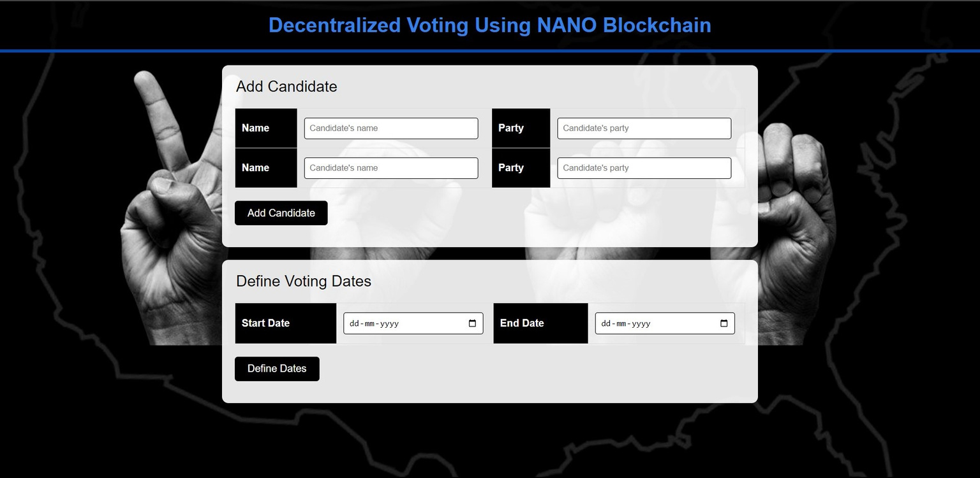
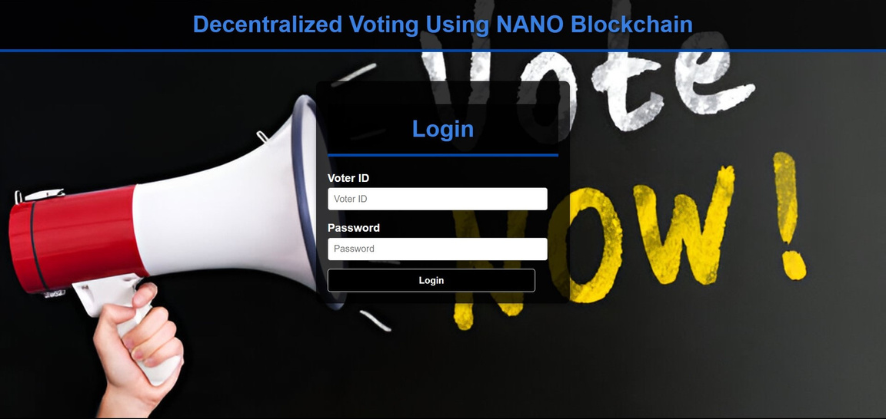
Work Done
WEBSITE DEVELOPMENT:-
LOGIN PAGE
ADMIN PAGE

Slide 7
Remaining work to be accomplished
Authentication of Registered Users Using Biometric Data
Generation of Principal Nano Node for the Admin
Generation of Nano Wallets
Cryptography of Votes and Voters
Display Live Vote Results on the Homepage

Slide 8
Conclusion
The blockchain-based e-voting system has advanced, integrating Nano nodes, an admin interface, and login pages connected to a MySQL database. This system ensures secure, decentralized vote recording and user authentication. However, more work is needed to complete the project, including creating Nano wallets for registered users, robust cryptographic measures, and biometric authentication. A Principal Nano node for admin and a real-time vote results dashboard are also essential.

Slide 9
References
Nano Node Repository. (n.d.). Retrieved from https://github.com/nanocurrency/nano-node
Voter Authentication Using Biometric and Facial Recognition Systems. (2023). MDPI. Retrieved from https://www.mdpi.com/2813-5288/2/4/17#:~:text=To%20verify%20each%20voter's%20information,biometric%20and%20facial%20recognition%20systems
Ethereum Documentation. (n.d.). Retrieved from https://ethereum.org/en/developers/docs/
Nano Community. (2023). Nano: The Fast, Feeless Cryptocurrency. Retrieved from https://nano.org/

Slide 10
Thank You

